Slide 1
The file system(unix)

Slide 2
Parent child relationship
The Unix file system has a hierarchical (or tree-like) structure with its highest level directory called root (denoted by /, pronounced slash). Immediately below the root level directory are several subdirectories, most of which contain system files. Below this can exist system files, application files, and/or user data files. Similar to the concept of the process parent-child relationship, all files on a Unix system are related to one another. That is, files also have a parent-child existence. Thus, all files (except one) share a common parental link, the top-most file (i.e. /) being the exception.
Below is a diagram (slice) of a "typical" Unix file system. As you can see, the top-most directory is / (slash), with the directories directly beneath being system directories. Note that as Unix implementations and vendors vary, so will this file system hierarchy. However, the organization of most file systems is similar.

Slide 3
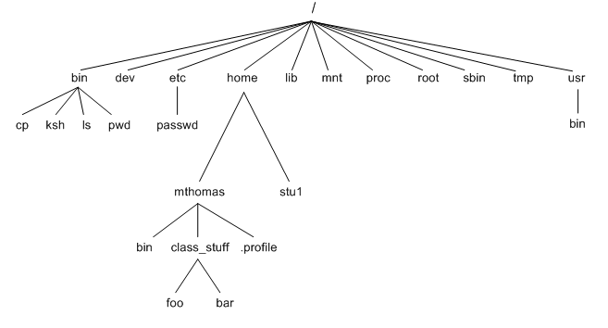
Continued…
Fig 6.1 Parent child relationship

Slide 4
The UNIX file system
Refering to Fig 6.1 Parent child relationship the following system files (i.e. directories) are present in most Unix filesystems:
bin - short for binaries, this is the directory where many commonly used executable commands reside
dev - contains device specific files
etc - contains system configuration files
home - contains user directories and files
lib - contains all library files
mnt - contains device files related to mounted devices
root - the root users' home directory (note this is different than /)
sbin - system binary files reside here. If there is no sbin directory on your system, these files most likely reside in etc
tmp - storage for temporary files which are periodically removed from the file system
usr - also contains executable commands

Slide 5
Absolute Pathnames
Absolute Pathname: it uses root directory as ultimate reference for the file. All path references here originate from root.
Example
cat /home/romeo/login.sql
cat here uses abslolute pathname, where location of login.sql is specified with reference to root(first /).

Slide 6
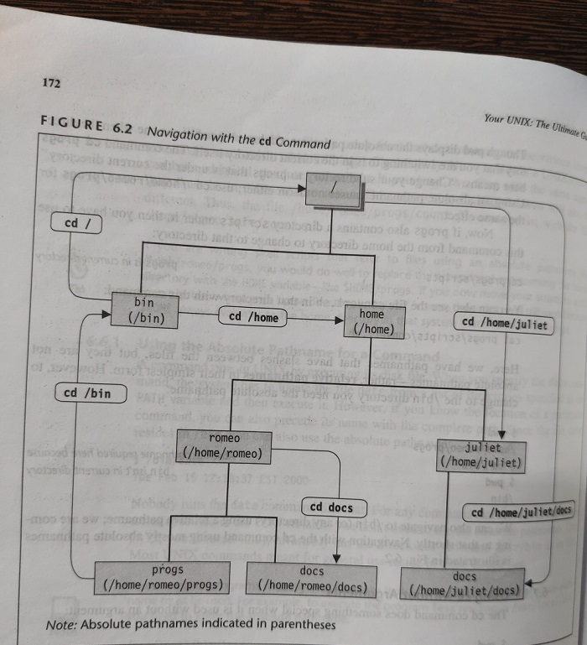
Absolute Pathname located in parentheses. Shown in fig below.

Slide 7
Relative pathname
Relative pathname : uses current directory as point of reference and specifies the path relative to it.
Sinlge dot (.) indicates current directory
Double dot(..) indicates parent directory.
Example
cd .. : with this command you will be able to change your directory to parent directory of the current directory.
cd .. / .. : moves two level up
cd ../ Juliet : moves one level up and then down.

Slide 8
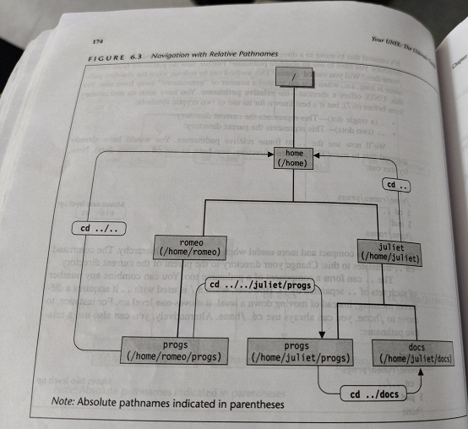

Slide 9
Unix commands
pwd
cd
mkdir
rmdir
cp
rm
mv
cat
ls

Slide 10
Continue..
pwd : to find the current directory
Synatx : $ pwd
o/p : /home/romeo
cd : this command is used to change your current directory and place you in another directory.
Synatax : cd directory name
Example : cd docs
o/p: $_
mkdir : this command is used to create a directory
Syntax : mkdir directory name
Eample : mkdir docs

Slide 11
rmdir: this command removes directories.
Syntax : rmdir options direcriry name
Example : rmdir pis
Above command removes directory named pis.
rmdir can also be used to remove multiple directories.
Example: rmdir pis prog
Above command removes directories named pis and prog.

Slide 12
cp : copying files
This command copies a file or group of files. The syntax requires at least two filenames to be specified in the command line.
Syntax: cp source destination
Example : cp chap unit
Above command copies content of chap file to unit file. If destination file does not exits then it will be created and later copying takes place.

Slide 13
rm : deleting files
This command deletes the files. This command can also be used to delete multiple files.
Syntax: rm options filenames
The options field is optional.
Example
rm chap
This command removes file called chap
rm chap file1 unit
This command removes 3 files named chap, file1 and unit.

Slide 14
mv : this command is used for
Renaming a file(or directory)
Moves a group of files to a different directory.
Renaming a file:
mv chap unit
It renames file chap to unit.
Moving files to directory
mv chap1 chap2 prog
It moves files chap1 and chap2 to a directory prog.

Slide 15
cat : displaying and creating files
Syntax: cat filenames
Example:
cat note
This command displays content of note file.
cat note file1

Slide 16
ls : listing files
This command is used to display files in current directory.
Syntax : ls options
Examples:
ls : this command used to display files in current directory.
ls prog : displays files contained in prog directory.

Slide 17
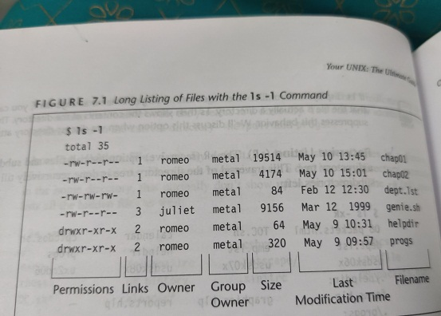
ls –l : used to list file attributes.
Output : the following output shows the attributes such as permission , links , owner of file etc. of files of current directory.

Slide 18
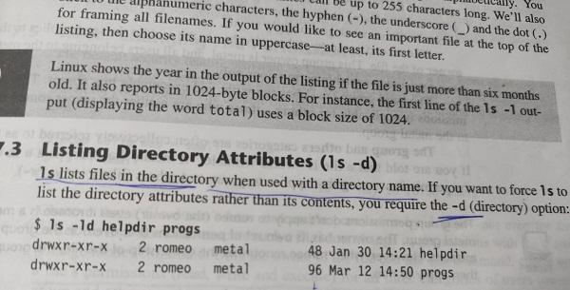
ls –d : this command is used to list the directory attributes.
Example : ls –ld helpdir progs
Output of command is shown below:

Slide 19
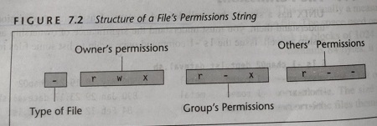
File Permission
To understand and to view file permission we must use ls –l command. Here its important to understand ownership and group ownership permissions as shown in below fig.
r indicates read permission which means cat can display file. w indicates write permission you can edit file. X indicates execute permission, you can execute it as a program. File permission is divided into 3 groups as shown in below fig.
1. owner’s permission 2. group permission 3. other’s permission
The first group has all permissions(rwx). That means owner can read, write and execute the file.
Second group has hyper in middle (r-x). That means all members of group can read and execute the file but they can write to file.
The third group (r--) has only read permission. That means other user can only read the file but can not write and execute the file.

Slide 20
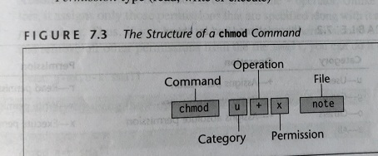
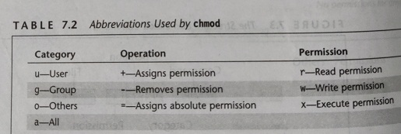
chmod : changing file permission
Chmod sets a file permissions(read, write, execute) for all three categories of users(owner, group and other) and uses following syntax.
syntax
chmod category operation permission file(s)
There are 3 components in the syntax
1. category of user(u-owner, g-group owner or o-other)
2. operation to be performed (assign or remove permission)
3. permission type(read, write or execute)

Slide 21
Examples
Check permission of file called as small
ls –l small
o/p: - r w – r - - r - - 1 romeo metal 10 may 10 10:30 small
1. Assign execute permission to user
chmod u+x small
Check permission of file called as small
ls –l small
o/p: - r w x r - - r - - 1 romeo metal 10 may 10 10:30 small
2. chmod g+wx small
Check permission of file called as small
ls –l small
o/p: - r w x r w x r - - 1 romeo metal 10 may 10 10:30 small
2. chmod o+w small

Slide 22
Using multiple expressions
1. chmod u+r, g+x small
2. chmod u+wx, g+x small
Absolute assignment
Here we use assignment operator (=) to assign permission and minus (-) to remove permission
chmod g-wx small -> remove write and execute permission from file small.
chmod g=x small -> assign execute permission to group owner
chmod a=r small -> giver read permission to all users(owner, group and other)
Octal notation
Each type of permission is a number.
4- read 2- write 1- execute
Example
chmod 666 small -> assign read, write permission to owner, group and other users.
chmod 644 small -> assign read, write permission to owner, read permission to group and read permission to other.

